Slide 1

Netty 3
Dima Ionut Daniel

Slide 2
Contents
What is Netty?
Architecture
Netty Features
Netty Core
Conclusions
Bibliography

Slide 3

What is Netty?
Netty is a non-blocking I/O(NIO) client/server framework for the development of Java network applications.
The asynchronouse event-driven network application and tools are used to simplify network programming such as TCP and UDP socket servers.
Netty also includes built-in HTTP protocol support, including the ability to run inside a servlet container.
Netty has support for WebSockets, integration with Google Protocol Buffers, SSL/TLS support, SPDY protocol, message compression.

Slide 4
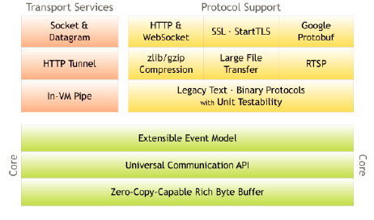
Architecture
Netty is very fast, performant, stable and flexible.
Netty is using the Separation of Concerns pattern.

Slide 5
Netty Features
Rich Buffer Data Structure
Netty uses its own buffer API instead of NIO ByteBuffer to represent a sequence of bytes.
Universal Asynchronous I/O API
Traditional I/O APIs in Java provide different types and methods for different transport types.
Event Model based on the Interceptor Chain Pattern
Netty has a welldefined event model focused on I/O.
A ChannelEvent is handled by a list of ChannelHandlers in a ChannelPipeline.

Slide 6
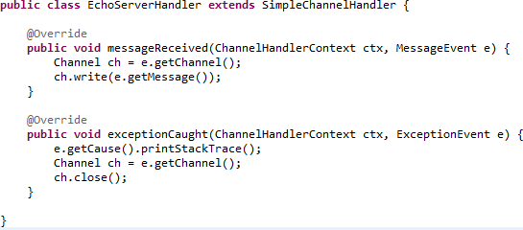
Netty Core
SimpleChannelHandler provides various event handler methods.
Methods receives an MessageEvent, which contains the received data, whenever new data is received from a client.
The exceptionCaught event handler method is called with an ExceptionEvent when an exception was raised.

Slide 7
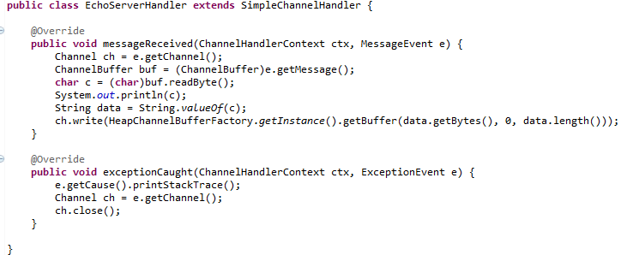
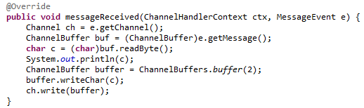
Netty Core (cont.)
It is safe to assume the message type in socket transports is always ChannelBuffer.
ChannelBuffer is a fundamental data structure which stores a sequence of bytes in Netty.

Slide 8
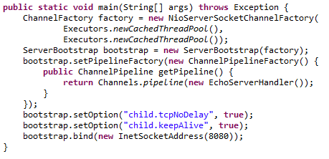
Netty Core (cont.)
ChannelFactory is a factory which creates and manages Channels and its related resources.
It processes all I/O requests and performs I/O to generate ChannelEvents.
ServerBootstrap is a helper class that sets up a server.
ChannelPipelineFactory creates a new ChannelPipeline for a new Channel.
When a server-side channel accepts a new incoming connection, a new child channel is created for each newly accepted connection.
Parameters that are specific to the Channel implementation can be set.
At the end we need to bind all NICs to a port using the bind() method.

Slide 9
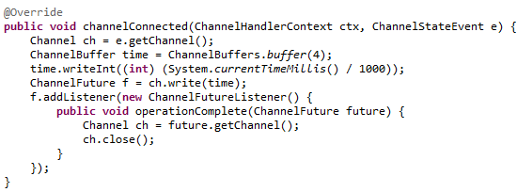
Netty Core (cont.)
The channelConnected method will be invoked when a connection is established.
We write the 32-bit integer that represents the current time.
A ChannelFuture represents an I/O operation which has not yet occurred.

Slide 10
Netty Core (cont.)
There are two variations for ChannelFactories: one for client channels and one for server channels.
UDP based channel factories are the same for clients and servers as they are considered connectionless.
The constructors for the TCP NIO ChannelFactories contains 2 thread pools:
boss threads: create and connect/bin sockets and pass them to worker threads
worker threads: performs all async I/O

Slide 11
Netty Core (cont.)
In Netty, everything occurs asynchronously, the driving code patterns consist of bits of code that generate events(like Connect, Disconnect and Write).
All these events in the Netty API are instances of the interface ChannelEvent.
We can add ChannelHandlers to the pipeline.
ChannelHandlers in use are probably encoders and decoders:
Encoder: converts a non ChannelBuffer object into a ChannelBuffer.
Decoder: reverse of an encoder where a ChannelBuffer's contents are converted in other objects.

Slide 12
Netty Core (cont.)
Any requested operation might not have been performed yet because all operations are asynchronous in Netty.
The following code might close the connection even before a message is sent.
We need to call the close method after the ChannelFuture, which was returned by the write method, notifies you when the write operation has been done.
The close operation also might not close the connection immediately, and it returns a ChannelFuture.
A ChannelEvent can be either an upstream or downstream event depending on the direction where the event flows.
Bad example:
Channel ch = ...;
ch.write(message);
ch.close();

Slide 13
Netty Core (cont.)
The shutdown process of a typical network application is done as:
Close all server sockets if there are any
Close all non-server sockets if they are any
Release all resourced used by ChannelFactory.

Slide 14
Conclusions
Netty supports non-blocking async I/O using Java NIO API.

Slide 15

Bibliography
http://en.wikipedia.org/wiki/Netty_(software)

